Slide 1
COULOMB’S LAW AND ELECTRIC FIELD INTENSITY

Slide 2
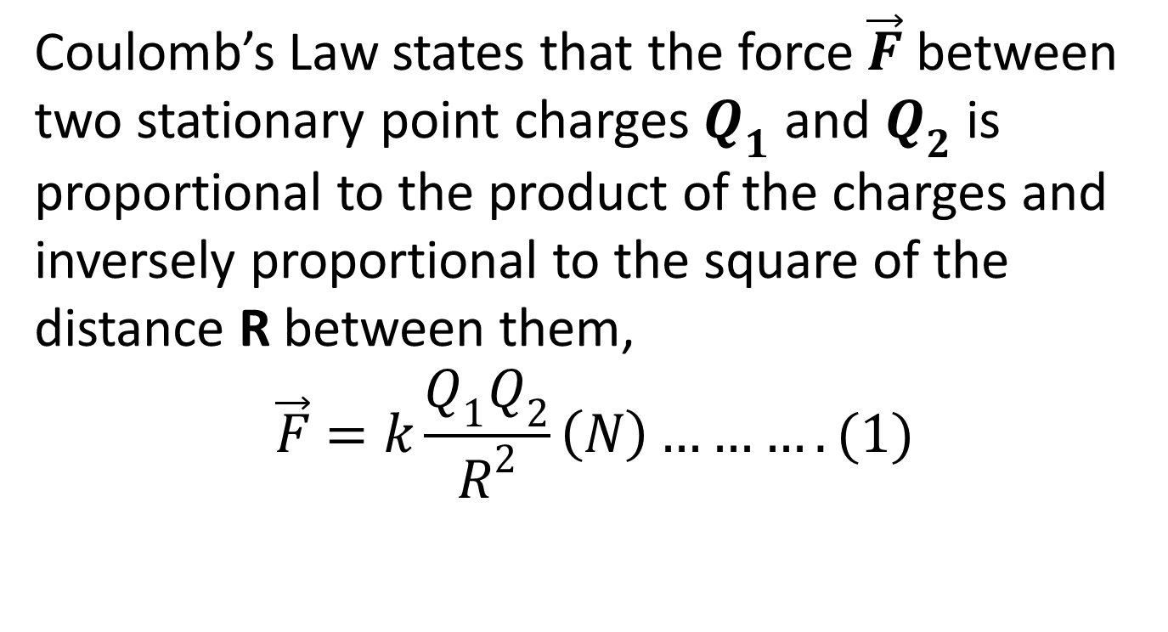
Force between Point Charges (Coulomb’s Law)
Coulomb’s Law states that the force $\vec{F}$ between two stationary point charges $Q_{1}$ and $Q_{2}$ is proportional to the product of the charges and inversely proportional to the square of the distance R between them,
$$\vec{F}=k\frac{Q_{1}Q_{2}}{R^{2}}\left(N\right)……….(1)$$

Slide 3
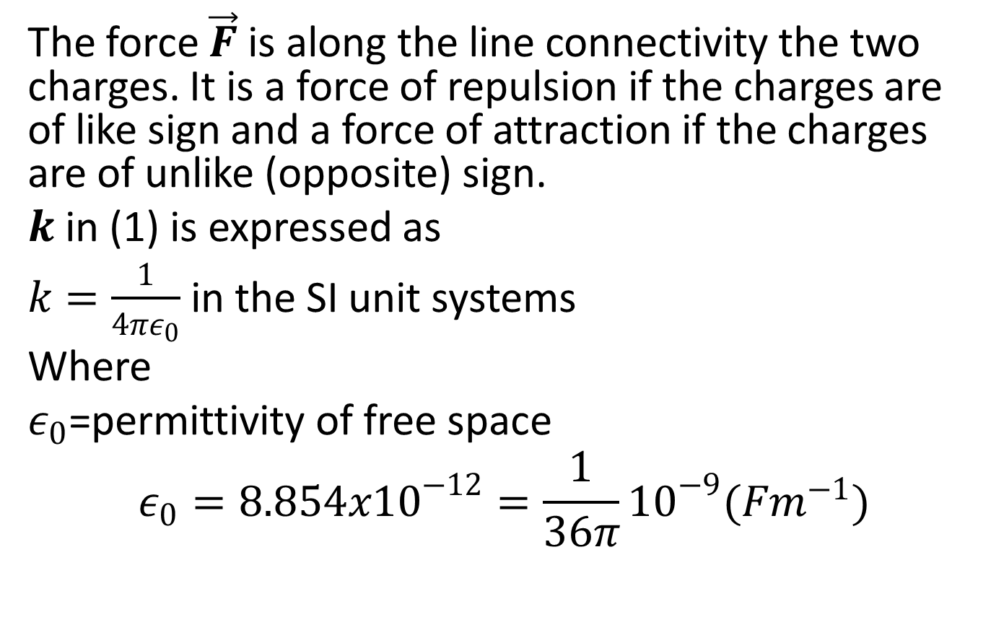
The force $\vec{F}$ is along the line connectivity the two charges. It is a force of repulsion if the charges are of like sign and a force of attraction if the charges are of unlike (opposite) sign.
$k$ in (1) is expressed as
$k=\frac{1}{4πε_{0}}$ in the SI unit systems
Where
$ε_{0}$=permittivity of free space
$$ε_{0}=8.854x{10}^{−12}=\frac{1}{36π}{10}^{−9}(Fm^{−1})$$

Slide 4
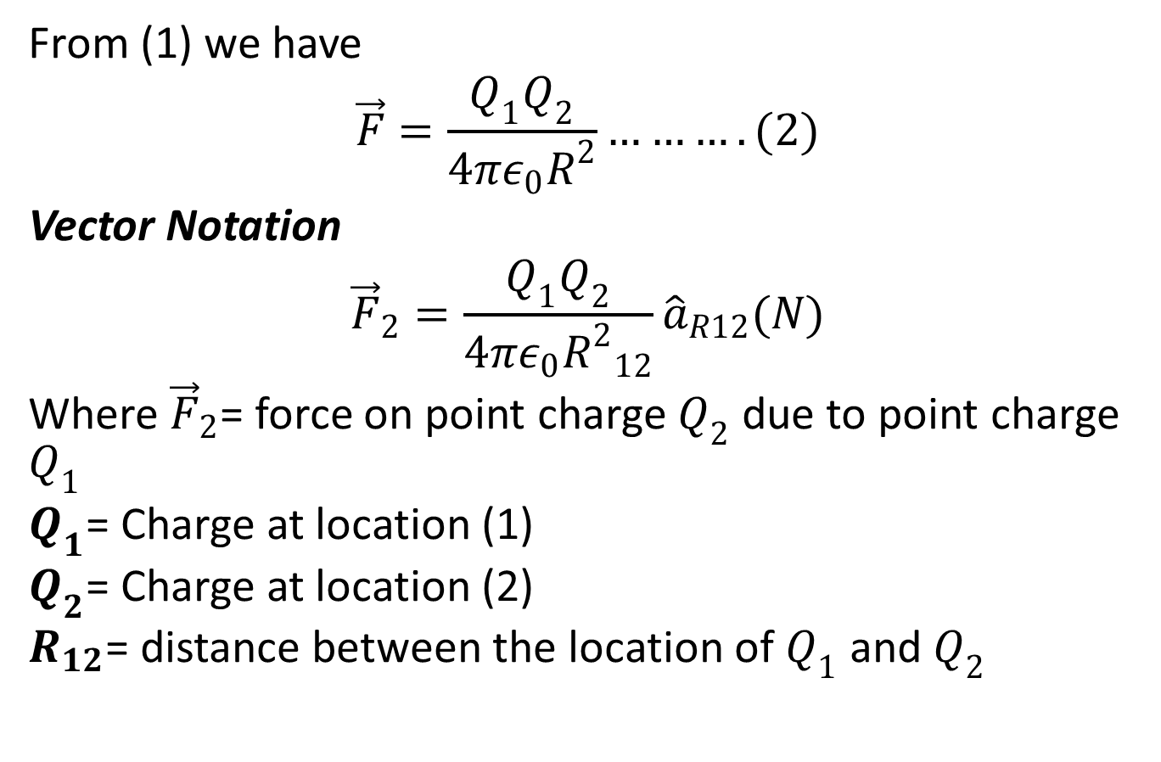
From (1) we have
$$\vec{F}=\frac{Q_{1}Q_{2}}{4πε_{0}R^{2}}……….(2)$$
Vector Notation
$${\vec{F}}_{2}=\frac{Q_{1}Q_{2}}{4πε_{0}{R^{2}}_{12}}{\hat{a}}_{R12}(N)$$
Where ${\vec{F}}_{2}$= force on point charge $Q_{2}$ due to point charge $Q_{1}$
$Q_{1}$= Charge at location (1)
$Q_{2}$= Charge at location (2)
$R_{12}$= distance between the location of $Q_{1}$ and $Q_{2}$

Slide 5
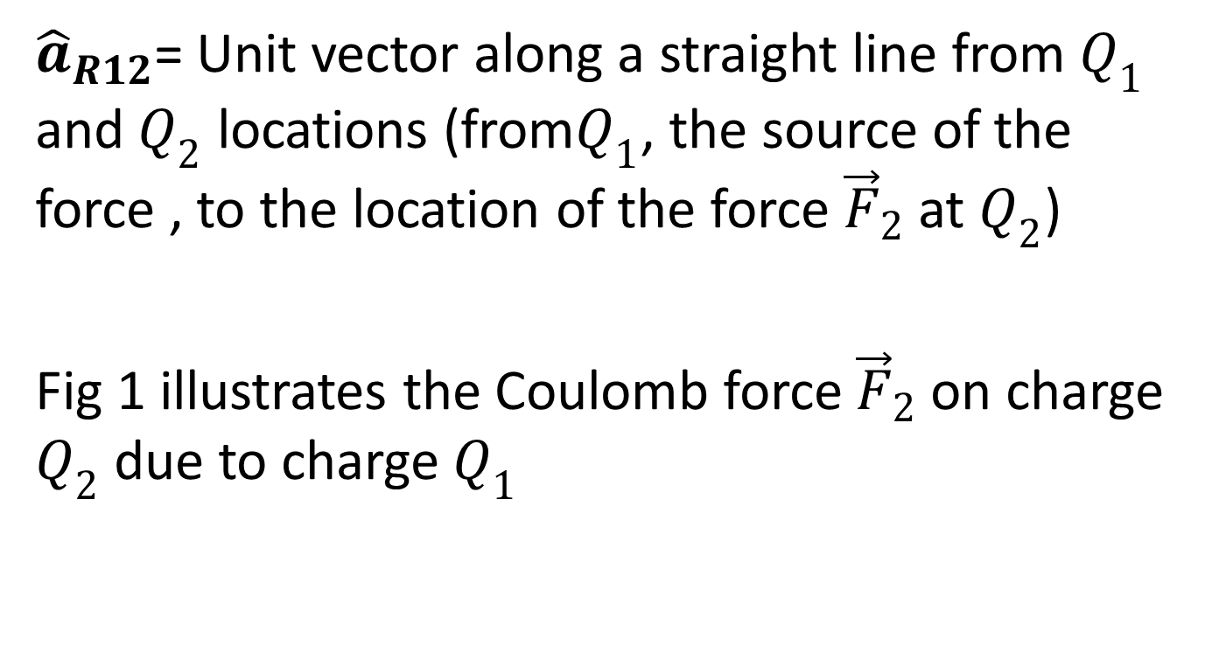
${\hat{a}}_{R12}$= Unit vector along a straight line from $Q_{1}$ and $Q_{2}$ locations (from$Q_{1}$, the source of the force , to the location of the force ${\vec{F}}_{2}$ at $Q_{2}$)
Fig 1 illustrates the Coulomb force ${\vec{F}}_{2}$ on charge $Q_{2}$ due to charge $Q_{1}$

Slide 6
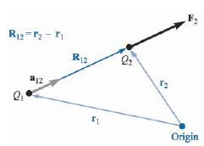
Fig 1

Slide 7
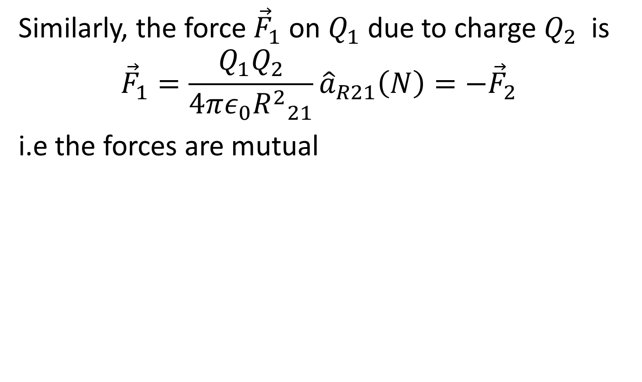
Similarly, the force ${\vec{F}}_{1}$ on $Q_{1}$ due to charge $Q_{2}$ is
$${\vec{F}}_{1}=\frac{Q_{1}Q_{2}}{4πε_{0}{R^{2}}_{21}}{\hat{a}}_{R21}\left(N\right)=−{\vec{F}}_{2}$$
i.e the forces are mutual

Slide 8
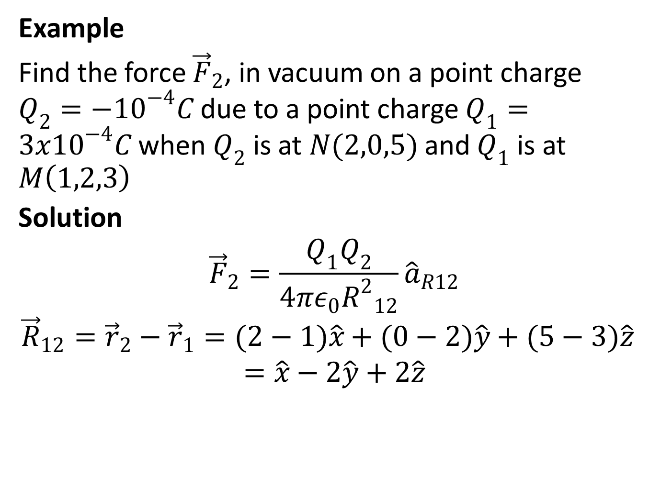
Example
Find the force ${\vec{F}}_{2}$, in vacuum on a point charge $Q_{2}={−10}^{−4}C$ due to a point charge $Q_{1}=3x{10}^{−4}C$ when $Q_{2}$ is at $N(2,0,5)$ and $Q_{1}$ is at $M\left(1,2,3\right)$
Solution
$${\vec{F}}_{2}=\frac{Q_{1}Q_{2}}{4πε_{0}{R^{2}}_{12}}{\hat{a}}_{R12}$$
$${\vec{R}}_{12}={\vec{r}}_{2}−{\vec{r}}_{1}=(2−1)\hat{x}+(0−2)\hat{y}+(5−3)\hat{z}$$
$$=\hat{x}−2\hat{y}+2\hat{z}$$

Slide 9
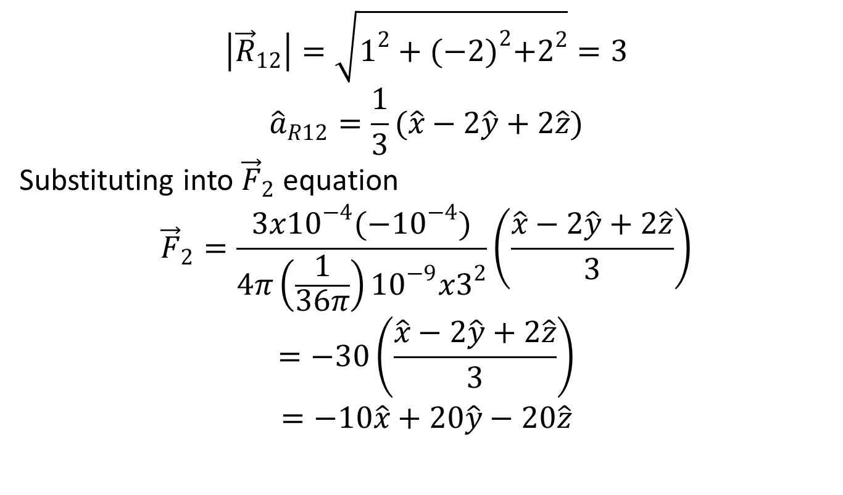
$$\left|{\vec{R}}_{12}\right|=\sqrt{1^{2}+{(−2)}^{2}+2^{2}}=3$$
$${\hat{a}}_{R12}=\frac{1}{3}(\hat{x}−2\hat{y}+2\hat{z})$$
Substituting into ${\vec{F}}_{2}$ equation
$${\vec{F}}_{2}=\frac{3x{10}^{−4}({−10}^{−4})}{4π\left(\frac{1}{36π}\right){10}^{−9}x3^{2}}\left(\frac{\hat{x}−2\hat{y}+2\hat{z}}{3}\right)$$
$$=−30\left(\frac{\hat{x}−2\hat{y}+2\hat{z}}{3}\right)$$
$$=−10\hat{x}+20\hat{y}−20\hat{z}$$

Slide 10
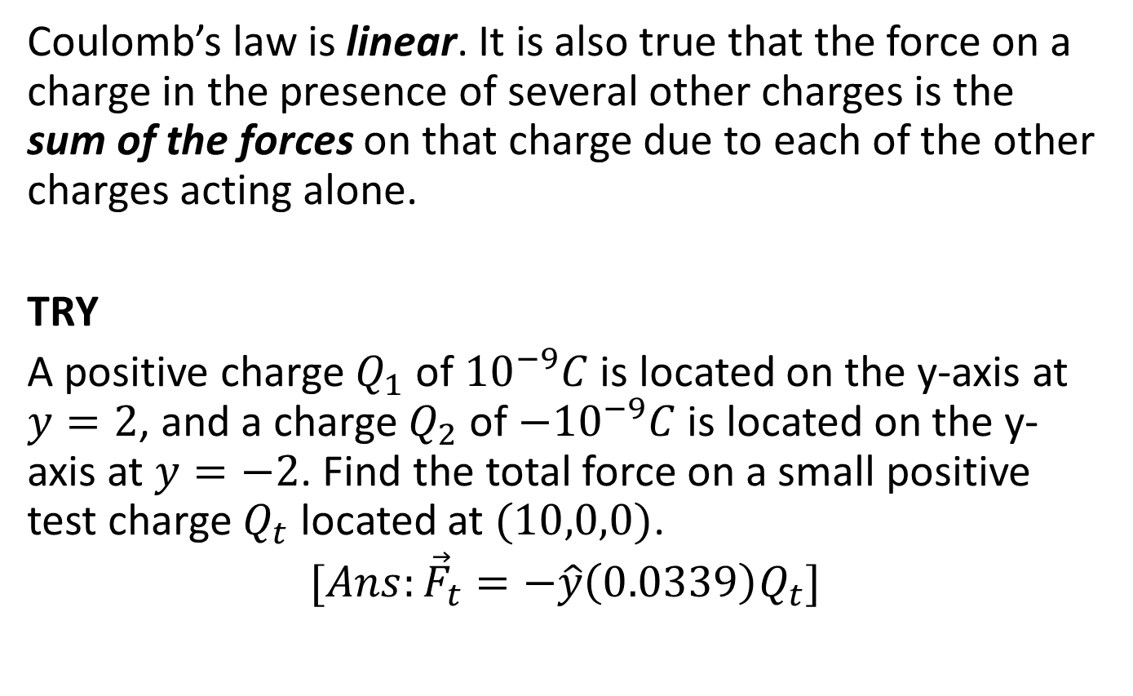
Coulomb’s law is linear. It is also true that the force on a charge in the presence of several other charges is the sum of the forces on that charge due to each of the other charges acting alone.
TRY
A positive charge $Q_{1}$ of ${10}^{−9}C$ is located on the y-axis at $y=2$, and a charge $Q_{2}$ of ${−10}^{−9}C$ is located on the y-axis at $y=−2$. Find the total force on a small positive test charge $Q_{t}$ located at $(10,0,0)$.
$$[Ans:{\vec{F}}_{t}=−\hat{y}\left(0.0339\right)Q_{t}]$$

Slide 12
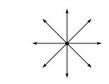
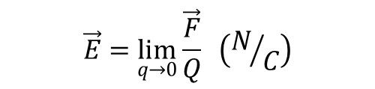
Electric Field Intensity
Electric field intensity is defined as the force per unit charge that a very small stationary test charge experiences when it is placed in a region where an electric field exist.
$$\vec{E}=\lim_{q→0}{\frac{\vec{F}}{Q}} \left(N/C\right)$$

Slide 13
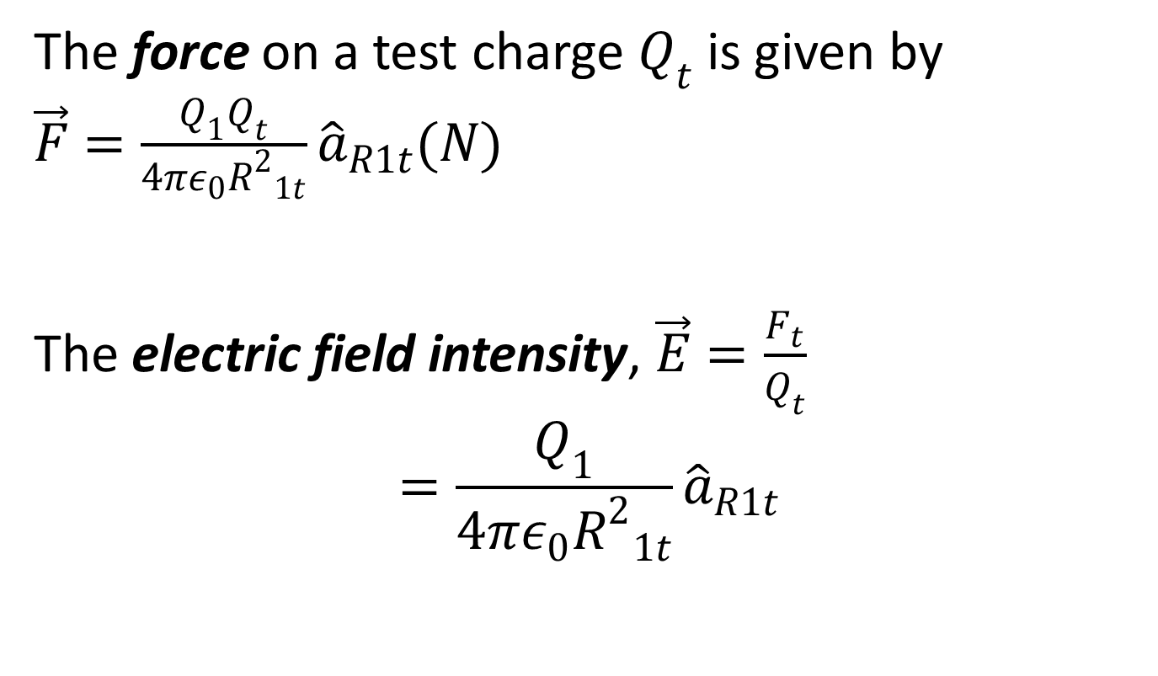
The force on a test charge $Q_{t}$ is given by $\vec{F}=\frac{Q_{1}Q_{t}}{4πε_{0}{R^{2}}_{1t}}{\hat{a}}_{R1t}(N)$
The electric field intensity, $\vec{E}=\frac{F_{t}}{Q_{t}}$
$$=\frac{Q_{1}}{4πε_{0}{R^{2}}_{1t}}{\hat{a}}_{R1t}$$

Slide 14
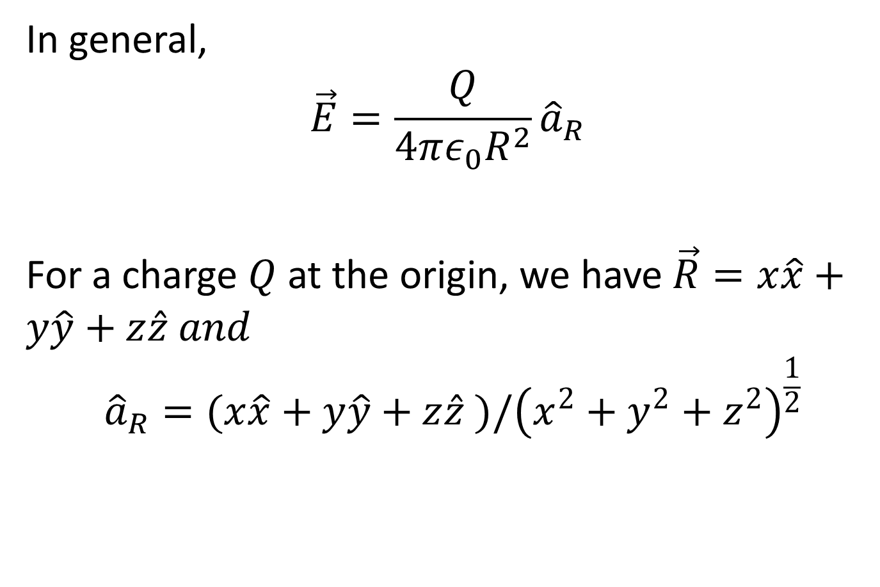
In general,
$$\vec{E}=\frac{Q}{4πε_{0}R^{2}}{\hat{a}}_{R}$$
For a charge $Q$ at the origin, we have $\vec{R}=x\hat{x}+y\hat{y}+z\hat{z} and$
$${\hat{a}}_{R}=(x\hat{x}+y\hat{y}+z\hat{z} )/{\left(x_{}^{2}+y_{}^{2}+z_{}^{2}\right)}^{\frac{1}{2}}$$

Slide 15
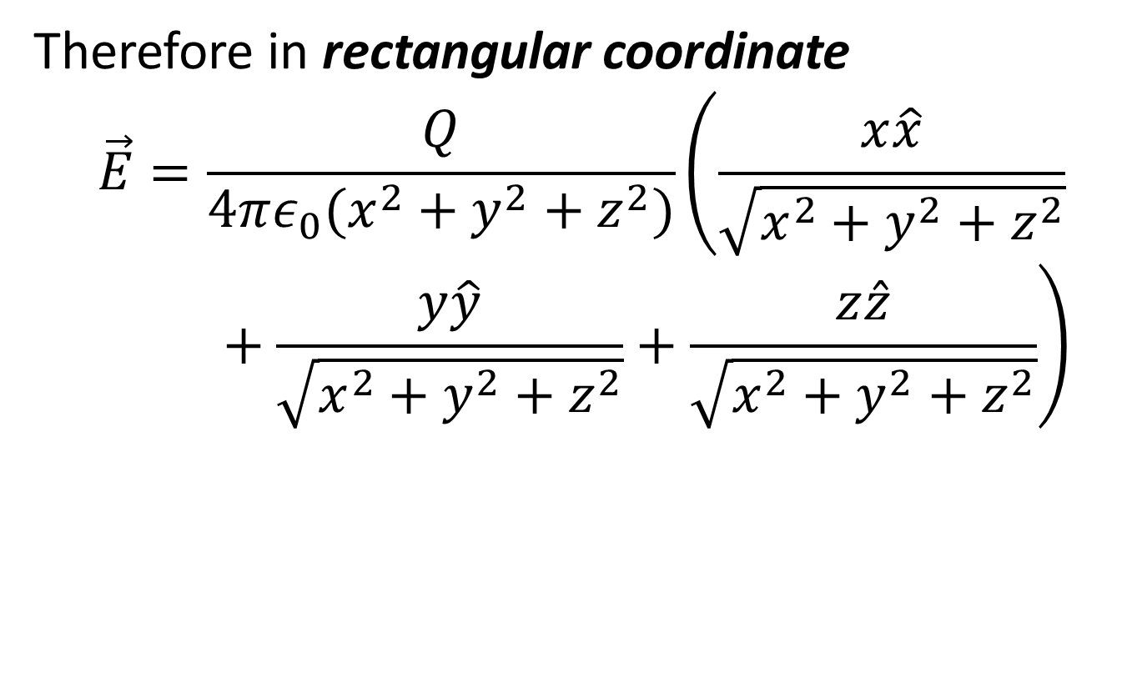
Therefore in rectangular coordinate
$$\vec{E}=\frac{Q}{4πε_{0}(x^{2}+y^{2}+z^{2})}\left(\frac{x\hat{x}}{\sqrt{x^{2}+y^{2}+z^{2}}}+\frac{y\hat{y}}{\sqrt{x^{2}+y^{2}+z^{2}}}+\frac{z\hat{z}}{\sqrt{x^{2}+y^{2}+z^{2}}}\right)$$

Slide 16
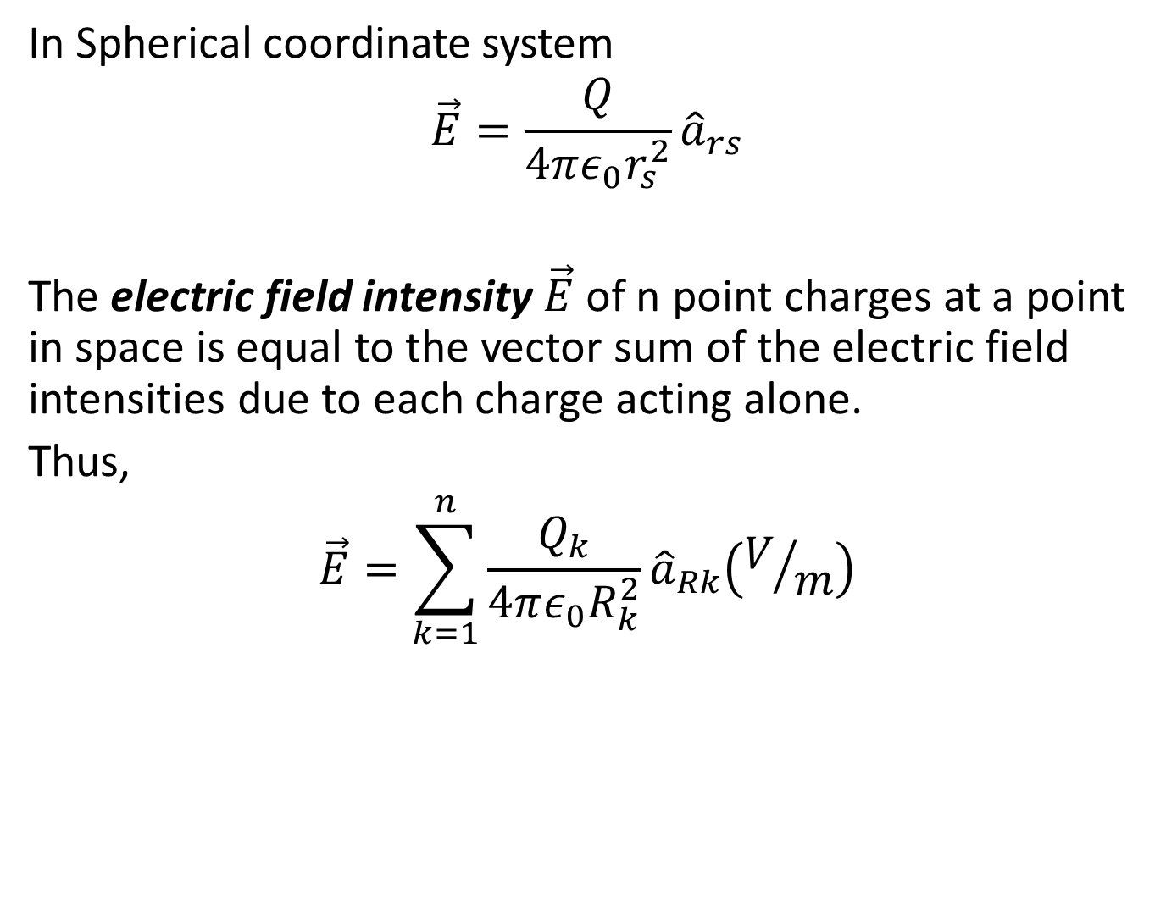
In Spherical coordinate system
$$\vec{E}=\frac{Q}{4πε_{0}r_{s}^{2}}{\hat{a}}_{rs}$$
The electric field intensity $\vec{E}$ of n point charges at a point in space is equal to the vector sum of the electric field intensities due to each charge acting alone.
Thus,
$$\vec{E}=\sum_{k=1}^{n}{\frac{Q_{k}}{4πε_{0}R_{k}^{2}}{\hat{a}}_{Rk}\left(V/m\right)}$$

Slide 17
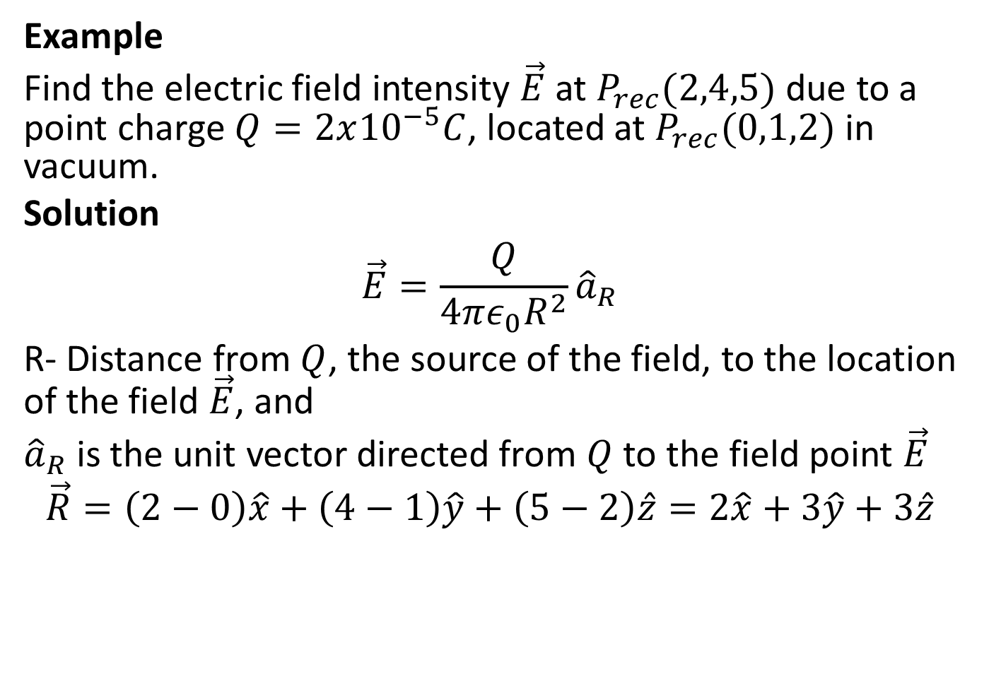
Example
Find the electric field intensity $\vec{E}$ at $P_{rec}(2,4,5)$ due to a point charge $Q=2x{10}^{−5}C$, located at $P_{rec}(0,1,2)$ in vacuum.
Solution
$$\vec{E}=\frac{Q}{4πε_{0}R^{2}}{\hat{a}}_{R}$$
R- Distance from $Q$, the source of the field, to the location of the field $\vec{E}$, and
${\hat{a}}_{R}$ is the unit vector directed from $Q$ to the field point $\vec{E}$
$$\vec{R}=\left(2−0\right)\hat{x}+\left(4−1\right)\hat{y}+\left(5−2\right)\hat{z}=2\hat{x}+3\hat{y}+3\hat{z}$$

Slide 18
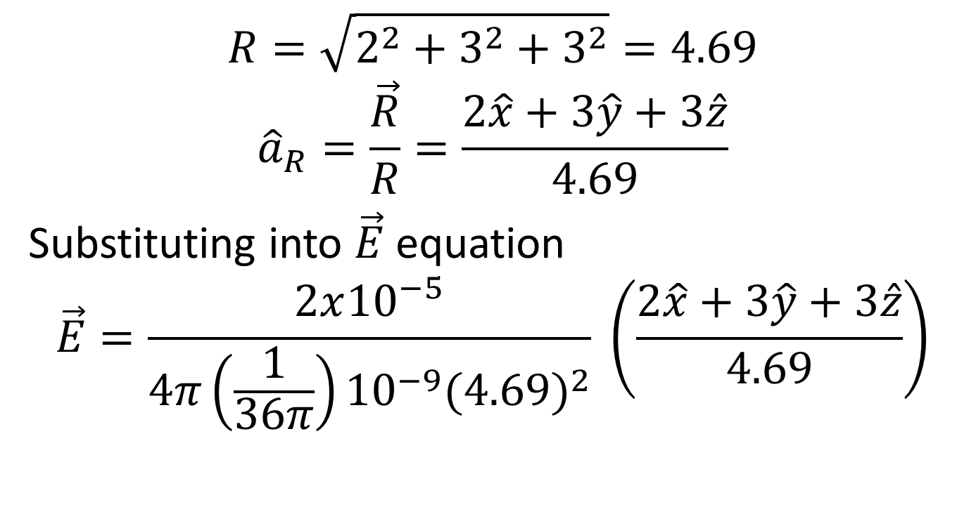
$$R=\sqrt{2^{2}+3^{2}+3^{2}}=4.69$$
$${\hat{a}}_{R}=\frac{\vec{R}}{R}=\frac{2\hat{x}+3\hat{y}+3\hat{z}}{4.69}$$
Substituting into $\vec{E}$ equation
$$\vec{E}=\frac{2x{10}^{−5}}{4π\left(\frac{1}{36π}\right){10}^{−9}{(4.69)}^{2}} \left(\frac{2\hat{x}+3\hat{y}+3\hat{z}}{4.69}\right)$$

Slide 19
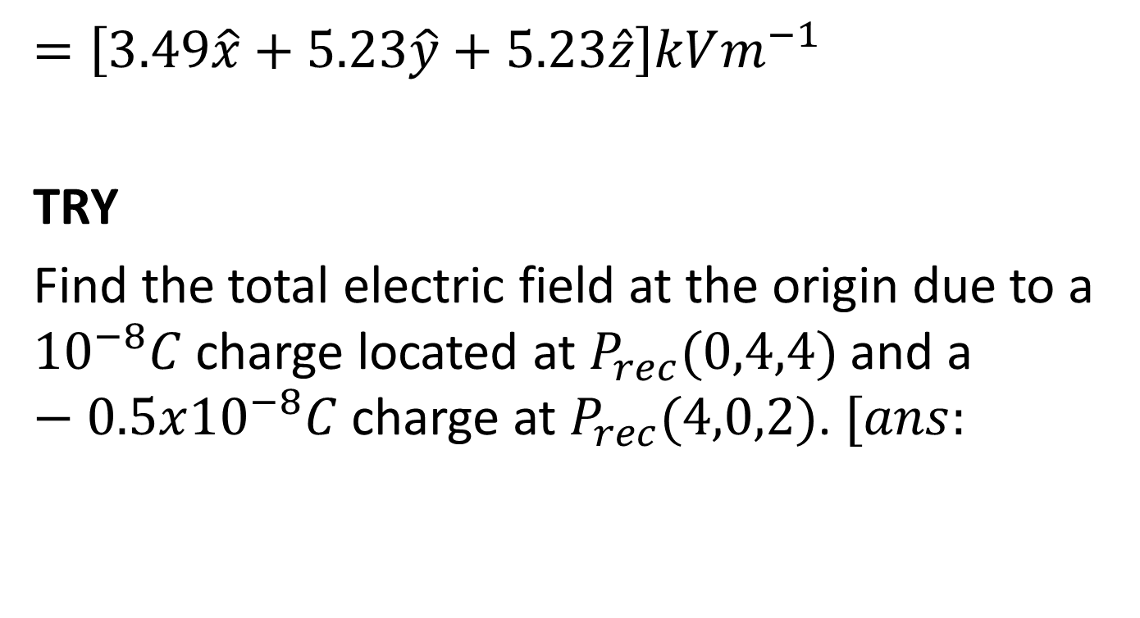
$=\left[3.49\hat{x}+5.23\hat{y}+5.23\hat{z}\right]kVm^{−1}$
TRY
Find the total electric field at the origin due to a ${10}^{−8}C$ charge located at $P_{rec}(0,4,4)$ and a $−0.5x{10}^{−8}C$ charge at $P_{rec}(4,0,2)$. $[ans:$

Slide 20
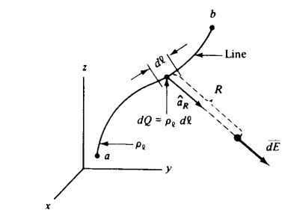
Electric Field Intensity of a Line of Charge

Slide 21
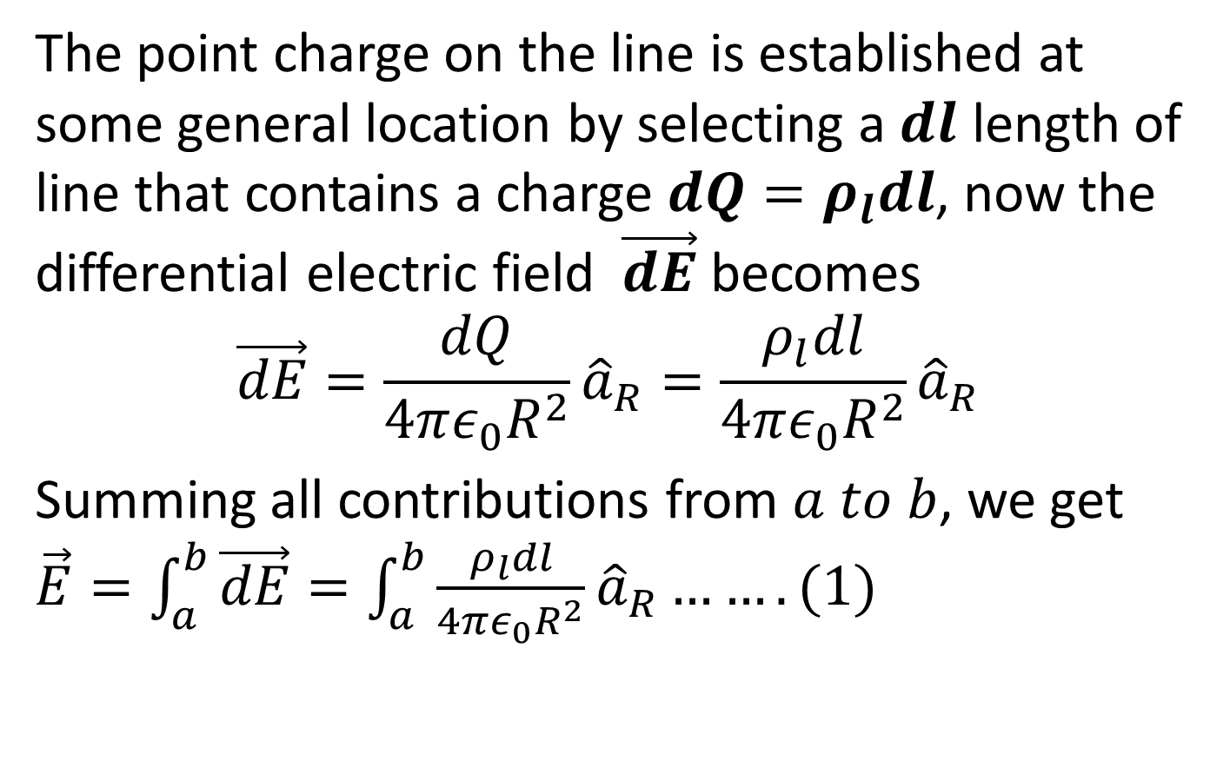
The point charge on the line is established at some general location by selecting a $dl$ length of line that contains a charge $dQ=ρ_{l}dl$, now the differential electric field $\vec{dE}$ becomes
$$\vec{dE}=\frac{dQ}{4πε_{0}R^{2}}{\hat{a}}_{R}=\frac{ρ_{l}dl}{4πε_{0}R^{2}}{\hat{a}}_{R}$$
Summing all contributions from $a to b$, we get $\vec{E}=\int_{a}^{b}{\vec{dE}}=\int_{a}^{b}{\frac{ρ_{l}dl}{4πε_{0}R^{2}}{\hat{a}}_{R}}…….(1)$

Slide 22
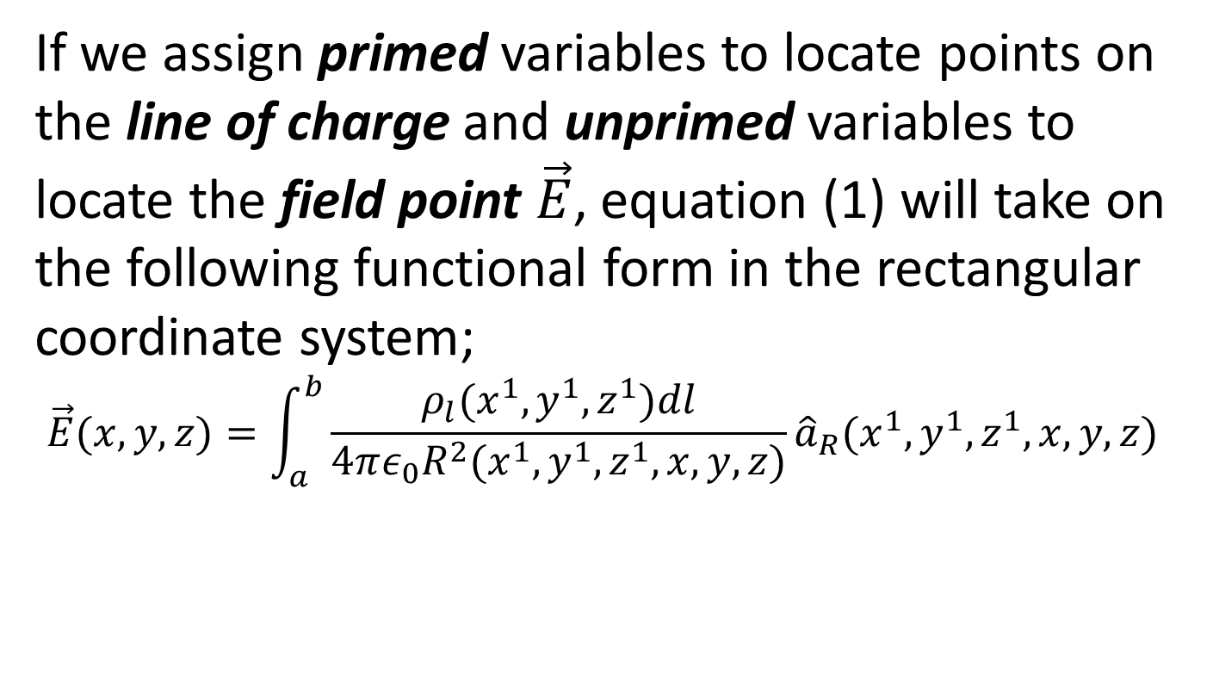
If we assign primed variables to locate points on the line of charge and unprimed variables to locate the field point $\vec{E}$, equation (1) will take on the following functional form in the rectangular coordinate system;
$$\vec{E}(x,y,z)=\int_{a}^{b}{\frac{ρ_{l}(x^{1},y^{1},z^{1})dl}{4πε_{0}R^{2}(x^{1},y^{1},z^{1},x,y,z)}{\hat{a}}_{R}(x^{1},y^{1},z^{1},x,y,z)}$$

Slide 23
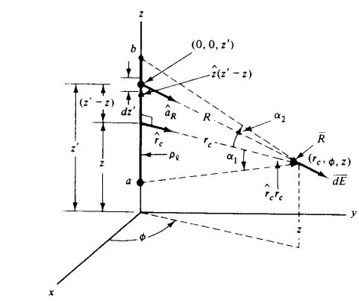

Example
Find the electric field intensity about the finite line charge of uniform $ρ_{l}$ distribution along the z-axis, as shown below.

Slide 24
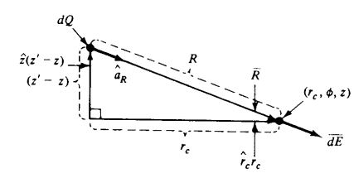
Let us use the primed variables to locate points on the line of charge and the unprimed variable to locate the electric field point.

Slide 25
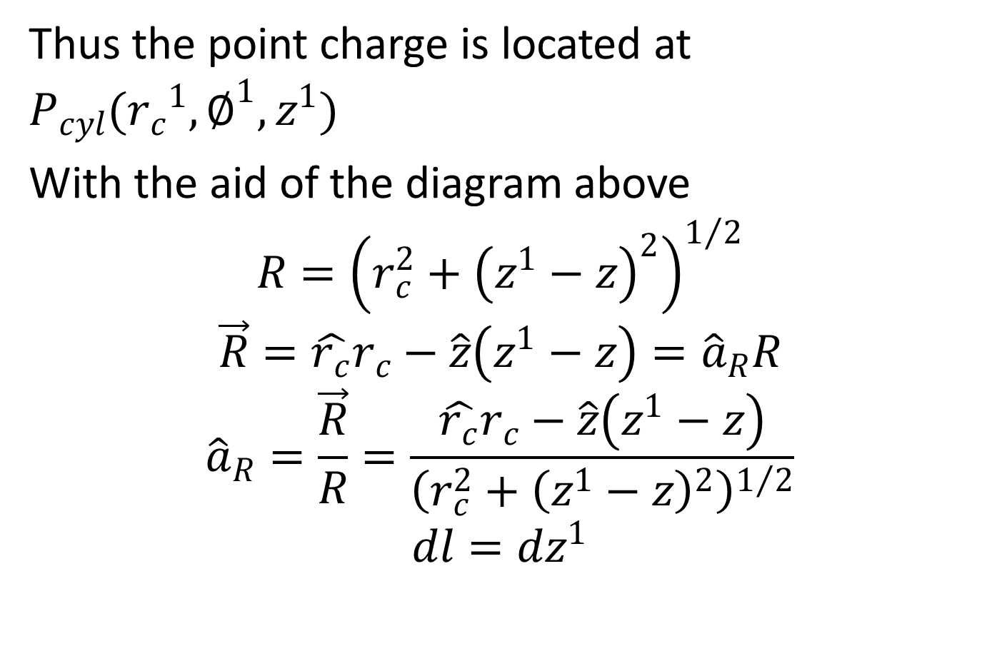
Thus the point charge is located at $P_{cyl}({r_{c}}^{1},∅^{1},z^{1})$
With the aid of the diagram above
$$R={\left(r_{c}^{2}+{\left(z^{1}−z\right)}^{2}\right)}^{1/2}$$
$$\vec{R}=\hat{r_{c}}r_{c}−\hat{z}\left(z^{1}−z\right)={\hat{a}}_{R}R$$
$${\hat{a}}_{R}=\frac{\vec{R}}{R}=\frac{\hat{r_{c}}r_{c}−\hat{z}\left(z^{1}−z\right)}{{\left(r_{c}^{2}+{\left(z^{1}−z\right)}^{2}\right)}^{1/2}}$$
$$dl=dz^{1}$$

Slide 26
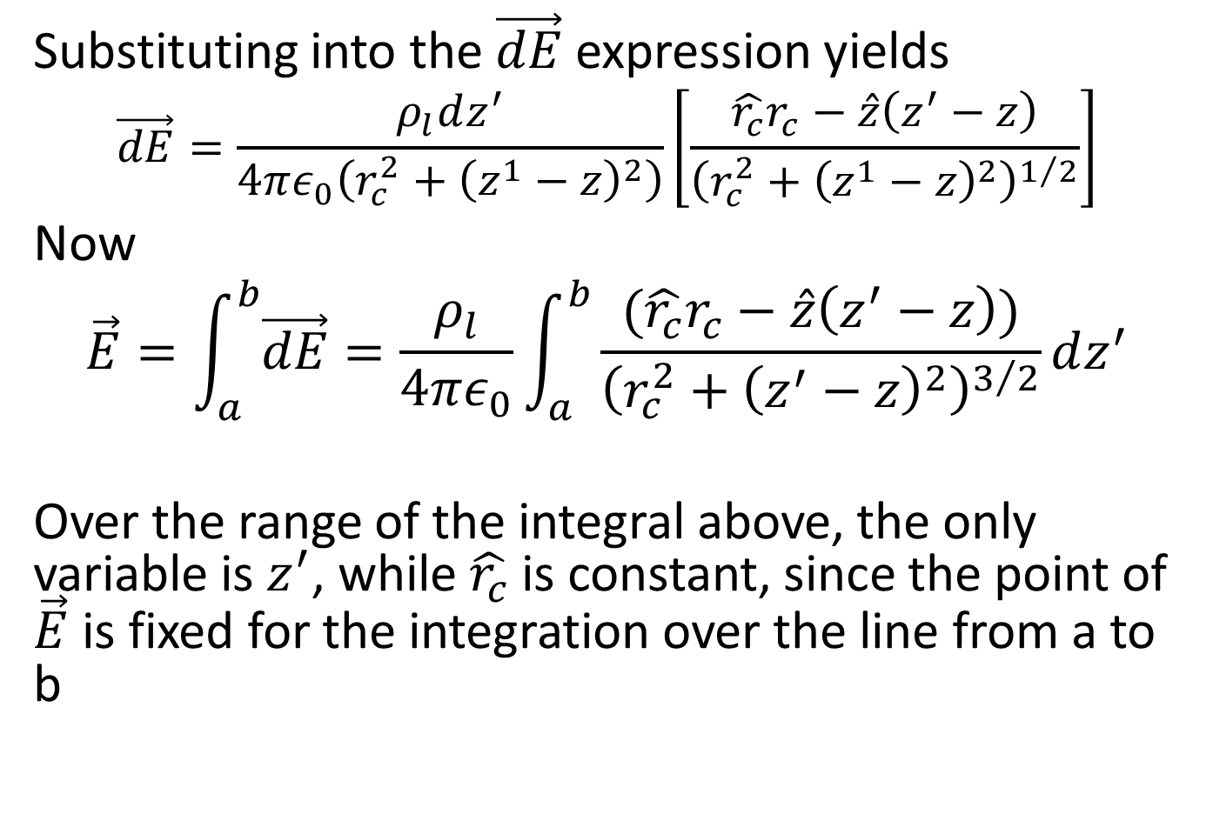
Substituting into the $\vec{dE}$ expression yields
$$\vec{dE}=\frac{ρ_{l}dz^{′}}{4πε_{0}\left(r_{c}^{2}+{\left(z^{1}−z\right)}^{2}\right)}\left[\frac{\hat{r_{c}}r_{c}−\hat{z}\left(z^{′}−z\right)}{{\left(r_{c}^{2}+{\left(z^{1}−z\right)}^{2}\right)}^{1/2}}\right]$$
Now
$$\vec{E}=\int_{a}^{b}{\vec{dE}}=\frac{ρ_{l}}{4πε_{0}}\int_{a}^{b}{\frac{(\hat{r_{c}}r_{c}−\hat{z}\left(z^{′}−z\right))}{{\left(r_{c}^{2}+{\left(z^{′}−z\right)}^{2}\right)}^{3/2}}}dz^{′}$$
Over the range of the integral above, the only variable is $z^{′}$, while $\hat{r_{c}}$ is constant, since the point of $\vec{E}$ is fixed for the integration over the line from a to b

Slide 27
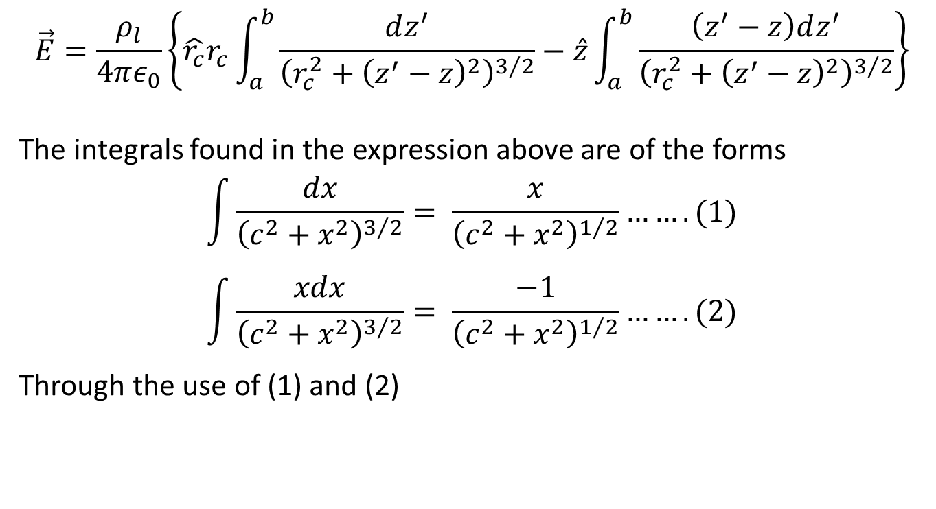
$$\vec{E}=\frac{ρ_{l}}{4πε_{0}}\left\{\hat{r_{c}}r_{c}\int_{a}^{b}{\frac{dz^{′}}{{\left(r_{c}^{2}+{\left(z^{′}−z\right)}^{2}\right)}^{3/2}}−\hat{z}\int_{a}^{b}{\frac{\left(z^{′}−z\right)dz^{′}}{{\left(r_{c}^{2}+{\left(z^{′}−z\right)}^{2}\right)}^{3/2}}}}\right\}$$
The integrals found in the expression above are of the forms
$$\int{\frac{dx}{{\left(c^{2}+x^{2}\right)}^{3/2}}}= \frac{x}{{\left(c^{2}+x^{2}\right)}^{1/2}}…….(1)$$
$$\int{\frac{xdx}{{\left(c^{2}+x^{2}\right)}^{3/2}}}= \frac{−1}{{\left(c^{2}+x^{2}\right)}^{1/2}}…….(2)$$
Through the use of (1) and (2)

Slide 28
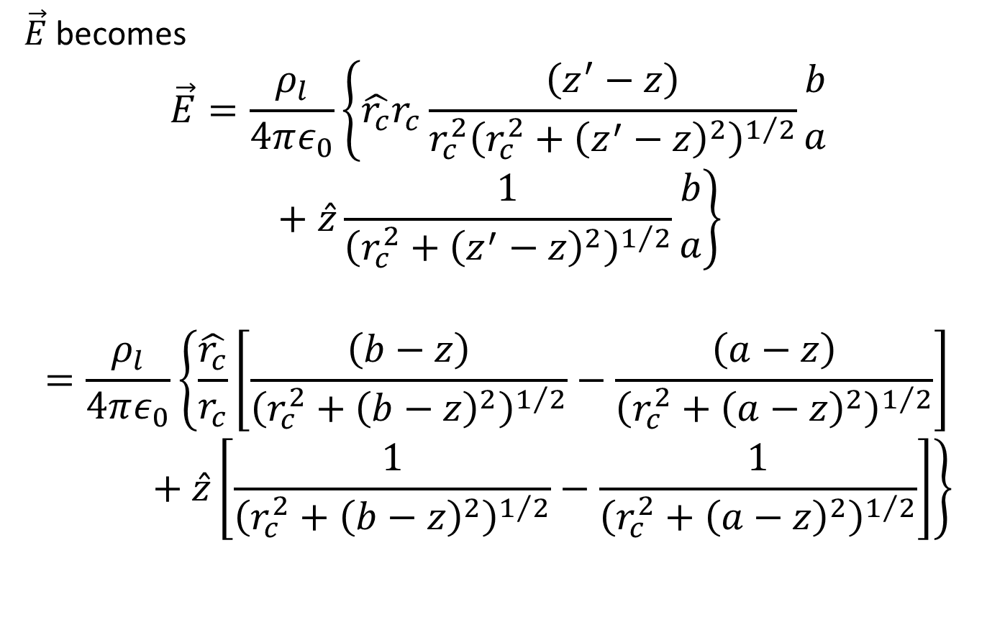
$\vec{E}$ becomes
$$\vec{E}=\frac{ρ_{l}}{4πε_{0}}\left\{\hat{r_{c}}r_{c}\frac{\left(z^{′}−z\right)}{{r_{c}^{2}\left(r_{c}^{2}+{\left(z^{′}−z\right)}^{2}\right)}^{1/2}}{b \atop a}+\hat{z}\frac{1}{{\left(r_{c}^{2}+{\left(z^{′}−z\right)}^{2}\right)}^{1/2}}{b \atop a}\right\}$$
$$=\frac{ρ_{l}}{4πε_{0}}\left\{\frac{\hat{r_{c}}}{r_{c}}\left[\frac{\left(b−z\right)}{{\left(r_{c}^{2}+{\left(b−z\right)}^{2}\right)}^{1/2}}−\frac{\left(a−z\right)}{{\left(r_{c}^{2}+{\left(a−z\right)}^{2}\right)}^{1/2}}\right]+\hat{z}\left[\frac{1}{{\left(r_{c}^{2}+{\left(b−z\right)}^{2}\right)}^{1/2}}−\frac{1}{{\left(r_{c}^{2}+{\left(a−z\right)}^{2}\right)}^{1/2}}\right]\right\}$$

Slide 29
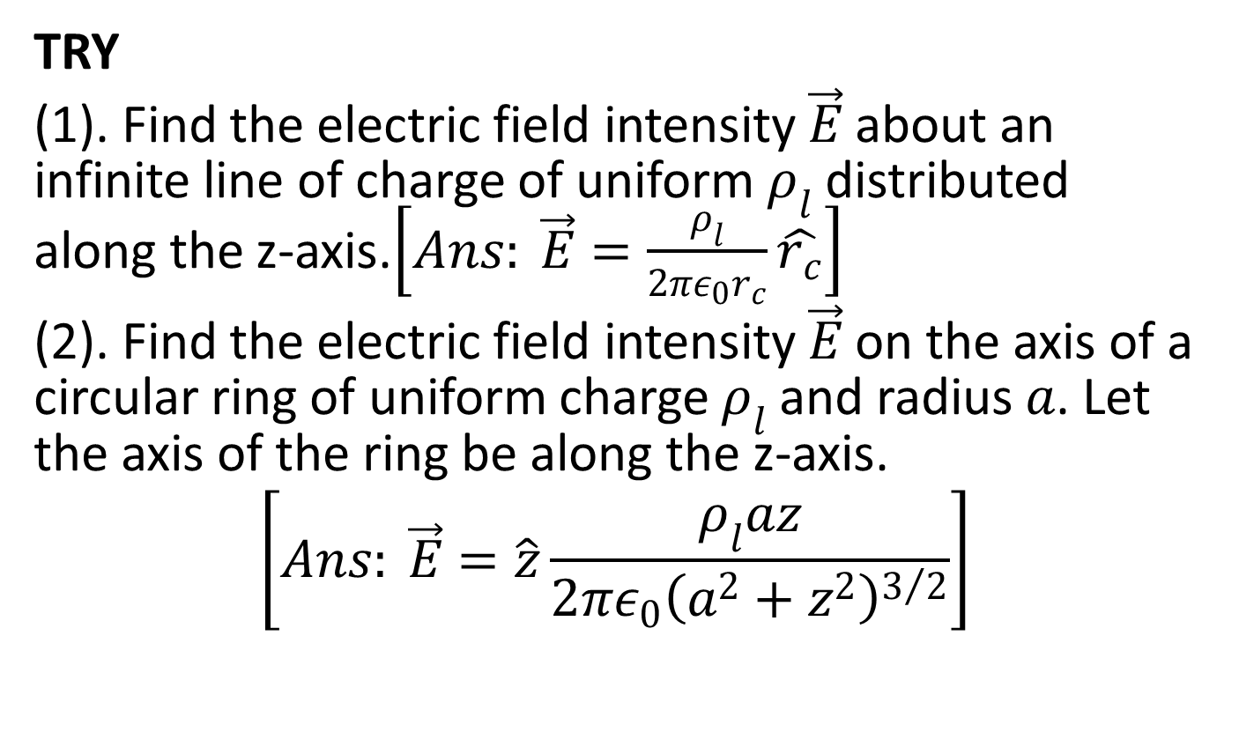
TRY
(1). Find the electric field intensity $\vec{E}$ about an infinite line of charge of uniform $ρ_{l}$ distributed along the z-axis.$\left[Ans: \vec{E}=\frac{ρ_{l}}{2πε_{0}r_{c}}\hat{r_{c}}\right]$
(2). Find the electric field intensity $\vec{E}$ on the axis of a circular ring of uniform charge $ρ_{l}$ and radius $a$. Let the axis of the ring be along the z-axis.
$$\left[Ans: \vec{E}=\hat{z}\frac{ρ_{l}az}{2πε_{0}{\left(a^{2}+z^{2}\right)}^{3/2}}\right]$$

Slide 30
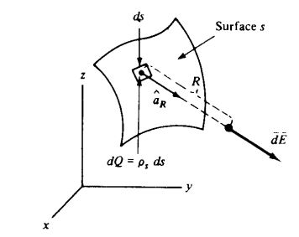
Electric Field Intensity of a Surface of Charge
For a surface charge distribution, as shown below.

Slide 31
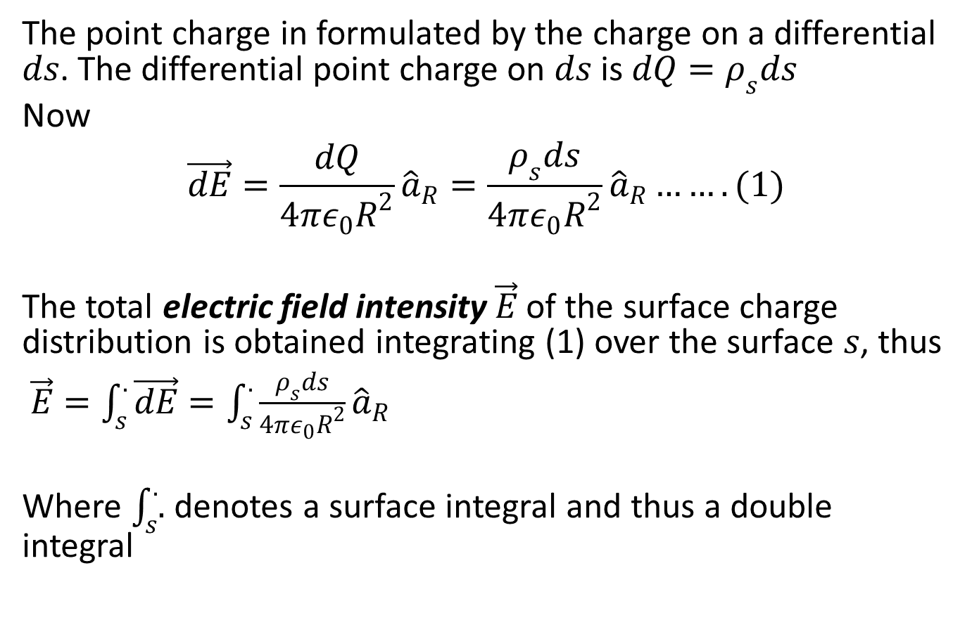
The point charge in formulated by the charge on a differential $ds$. The differential point charge on $ds$ is $dQ=ρ_{s}ds$
Now
$$\vec{dE}=\frac{dQ}{4πε_{0}R^{2}}{\hat{a}}_{R}=\frac{ρ_{s}ds}{4πε_{0}R^{2}}{\hat{a}}_{R}…….(1)$$
The total electric field intensity $\vec{E}$ of the surface charge distribution is obtained integrating (1) over the surface $s$, thus
$\vec{E}=\int_{s}^{.}{\vec{dE}}=\int_{s}^{.}{\frac{ρ_{s}ds}{4πε_{0}R^{2}}{\hat{a}}_{R}}$
Where $\int_{s}^{.}{.}$ denotes a surface integral and thus a double integral

Slide 32
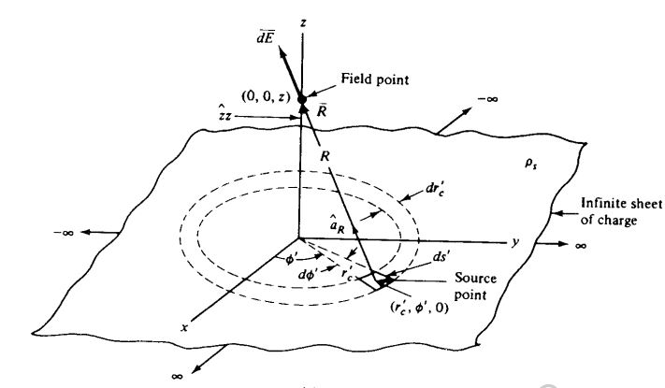

Example
Through the use of cylindrical coordinates, find the electric field intensity about an infinite sheet of uniform charge distribution $ρ_{s}$ as shown below.

Slide 33
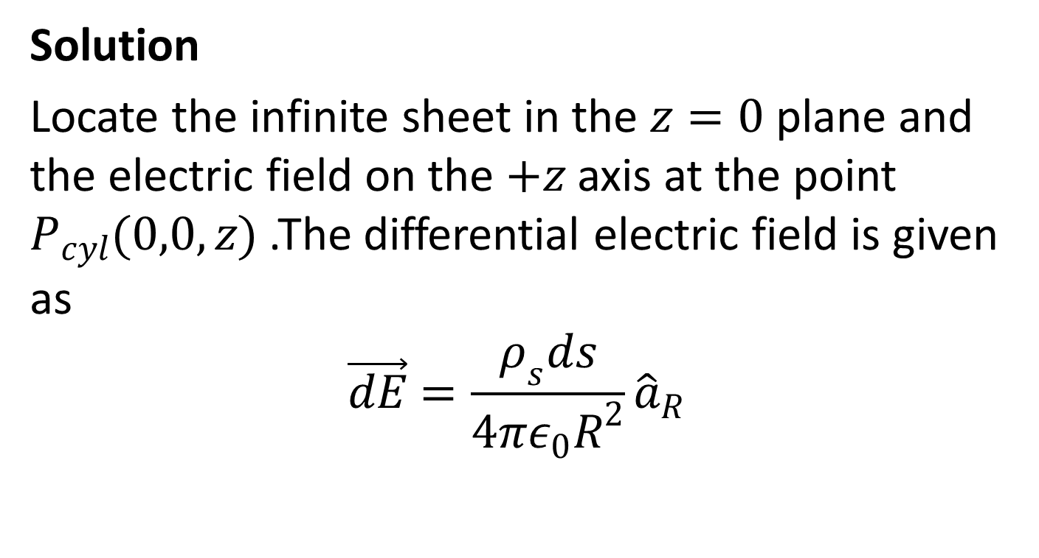
Solution
Locate the infinite sheet in the $z=0$ plane and the electric field on the $+z$ axis at the point $P_{cyl}(0,0,z)$ .The differential electric field is given as
$$\vec{dE}=\frac{ρ_{s}ds}{4πε_{0}R^{2}}{\hat{a}}_{R}$$

Slide 34
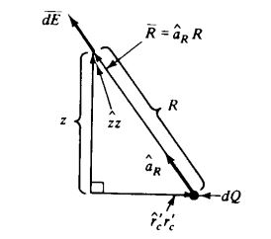

Slide 35
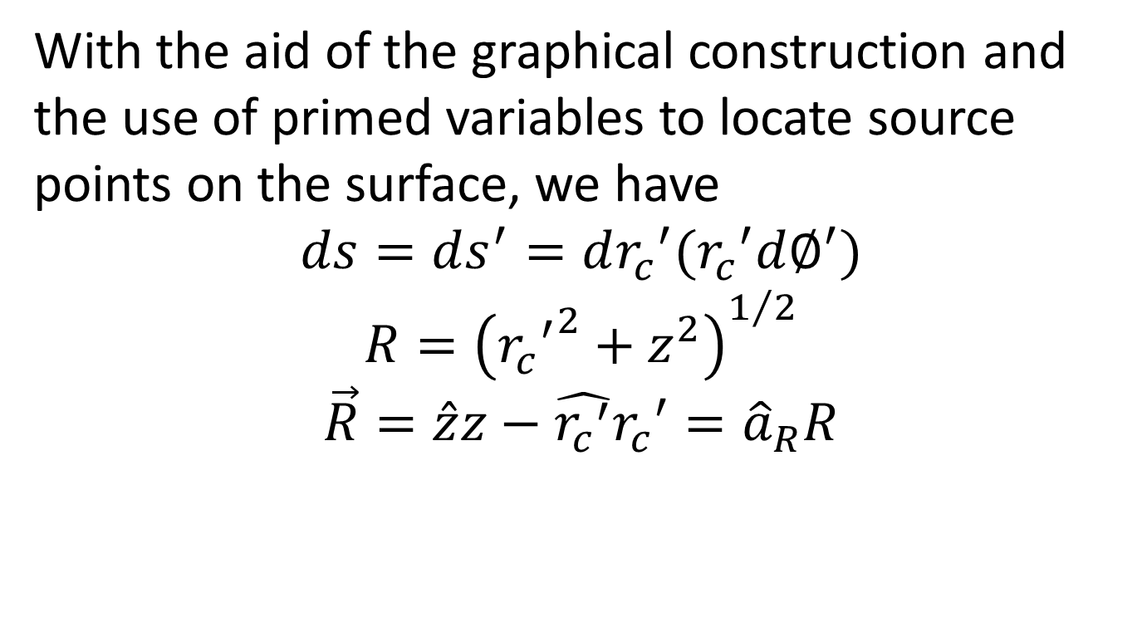
With the aid of the graphical construction and the use of primed variables to locate source points on the surface, we have
$$ds=ds^{′}=d{r_{c}}^{′}({r_{c}}^{′}d∅^{′})$$
$$R={\left({{r_{c}}^{′}}^{2}+z^{2}\right)}^{1/2}$$
$$\vec{R}=\hat{z}z−\hat{{r_{c}}^{′}}{r_{c}}^{′}={\hat{a}}_{R}R$$

Slide 36
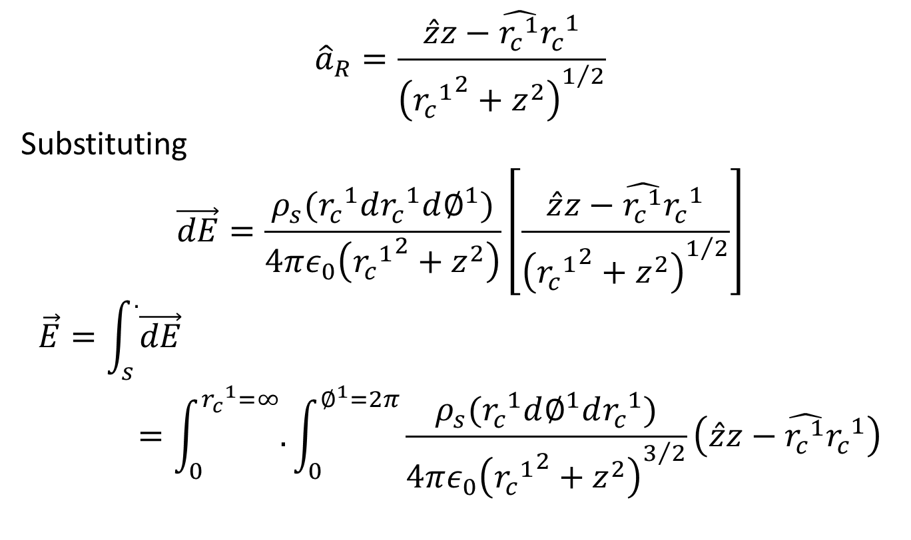
$${\hat{a}}_{R}=\frac{\hat{z}z−\hat{{r_{c}}^{1}}{r_{c}}^{1}}{{\left({{r_{c}}^{1}}^{2}+z^{2}\right)}^{1/2}}$$
Substituting
$$\vec{dE}=\frac{ρ_{s}({r_{c}}^{1}d{r_{c}}^{1}d∅^{1})}{4πε_{0}\left({{r_{c}}^{1}}^{2}+z^{2}\right)}\left[\frac{\hat{z}z−\hat{{r_{c}}^{1}}{r_{c}}^{1}}{{\left({{r_{c}}^{1}}^{2}+z^{2}\right)}^{1/2}}\right]$$
$$\vec{E}=\int_{s}^{.}{\vec{dE}}=\int_{0}^{{r_{c}}^{1}=∞}{.}\int_{0}^{∅^{1}=2π}{\frac{ρ_{s}({r_{c}}^{1}d∅^{1}d{r_{c}}^{1})}{4πε_{0}{\left({{r_{c}}^{1}}^{2}+z^{2}\right)}^{3/2}}\left(\hat{z}z−\hat{{r_{c}}^{1}}{r_{c}}^{1}\right)}$$

Slide 37
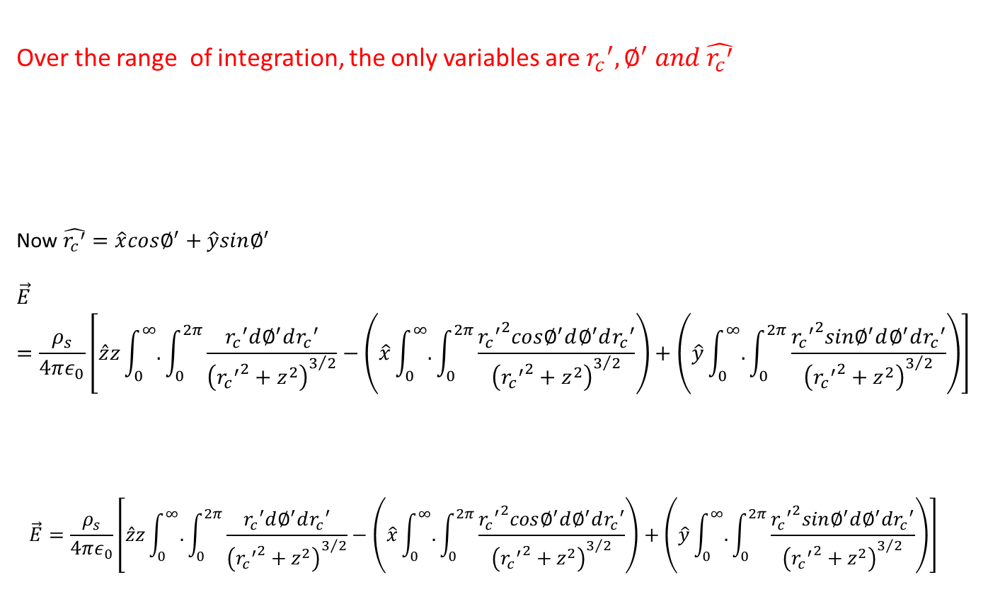
Over the range of integration, the only variables are ${r_{c}}^{′},∅^{′} and \hat{{r_{c}}^{′}}$
Now $\hat{{r_{c}}^{′}}=\hat{x}cos∅^{′}+\hat{y}sin∅^{′}$
$$\vec{E}=\frac{ρ_{s}}{4πε_{0}}\left[\hat{z}z\int_{0}^{∞}{.}\int_{0}^{2π}{\frac{{r_{c}}^{′}d∅^{′}d{r_{c}}^{′}}{{\left({{r_{c}}^{′}}^{2}+z^{2}\right)}^{3/2}}−\left(\hat{x}\int_{0}^{∞}{.}\int_{0}^{2π}{\frac{{{r_{c}}^{′}}^{2}cos∅^{′}d∅^{′}d{r_{c}}^{′}}{{\left({{r_{c}}^{′}}^{2}+z^{2}\right)}^{3/2}}}\right)+\left(\hat{y}\int_{0}^{∞}{.}\int_{0}^{2π}{\frac{{{r_{c}}^{′}}^{2}sin∅^{′}d∅^{′}d{r_{c}}^{′}}{{\left({{r_{c}}^{′}}^{2}+z^{2}\right)}^{3/2}}}\right)}\right]$$
$$\vec{E}=\frac{ρ_{s}}{4πε_{0}}\left[\hat{z}z\int_{0}^{∞}{.}\int_{0}^{2π}{\frac{{r_{c}}^{′}d∅^{′}d{r_{c}}^{′}}{{\left({{r_{c}}^{′}}^{2}+z^{2}\right)}^{3/2}}−\left(\hat{x}\int_{0}^{∞}{.}\int_{0}^{2π}{\frac{{{r_{c}}^{′}}^{2}cos∅^{′}d∅^{′}d{r_{c}}^{′}}{{\left({{r_{c}}^{′}}^{2}+z^{2}\right)}^{3/2}}}\right)+\left(\hat{y}\int_{0}^{∞}{.}\int_{0}^{2π}{\frac{{{r_{c}}^{′}}^{2}sin∅^{′}d∅^{′}d{r_{c}}^{′}}{{\left({{r_{c}}^{′}}^{2}+z^{2}\right)}^{3/2}}}\right)}\right]$$

Slide 38
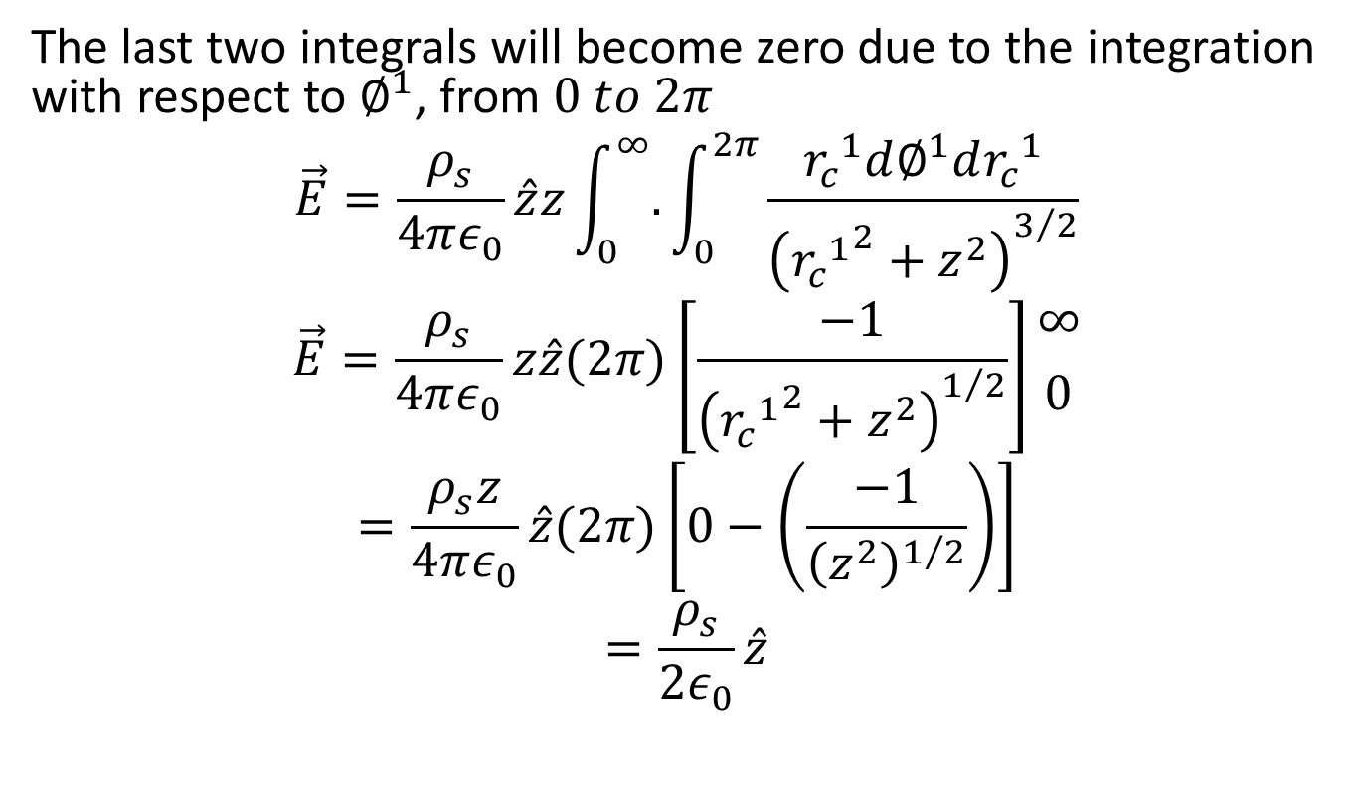
The last two integrals will become zero due to the integration with respect to $∅^{1}$, from $0 to 2π$
$$\vec{E}=\frac{ρ_{s}}{4πε_{0}}\hat{z}z\int_{0}^{∞}{.}\int_{0}^{2π}{\frac{{r_{c}}^{1}d∅^{1}d{r_{c}}^{1}}{{\left({{r_{c}}^{1}}^{2}+z^{2}\right)}^{3/2}}}$$
$$\vec{E}=\frac{ρ_{s}}{4πε_{0}}z\hat{z}(2π)\left[\frac{−1}{{\left({{r_{c}}^{1}}^{2}+z^{2}\right)}^{1/2}}\right]{∞ \atop 0}$$
$$=\frac{ρ_{s}z}{4πε_{0}}\hat{z}(2π)\left[0−\left(\frac{−1}{{\left(z^{2}\right)}^{1/2}}\right)\right]$$
$$=\frac{ρ_{s}}{2ε_{0}}\hat{z}$$

Slide 39
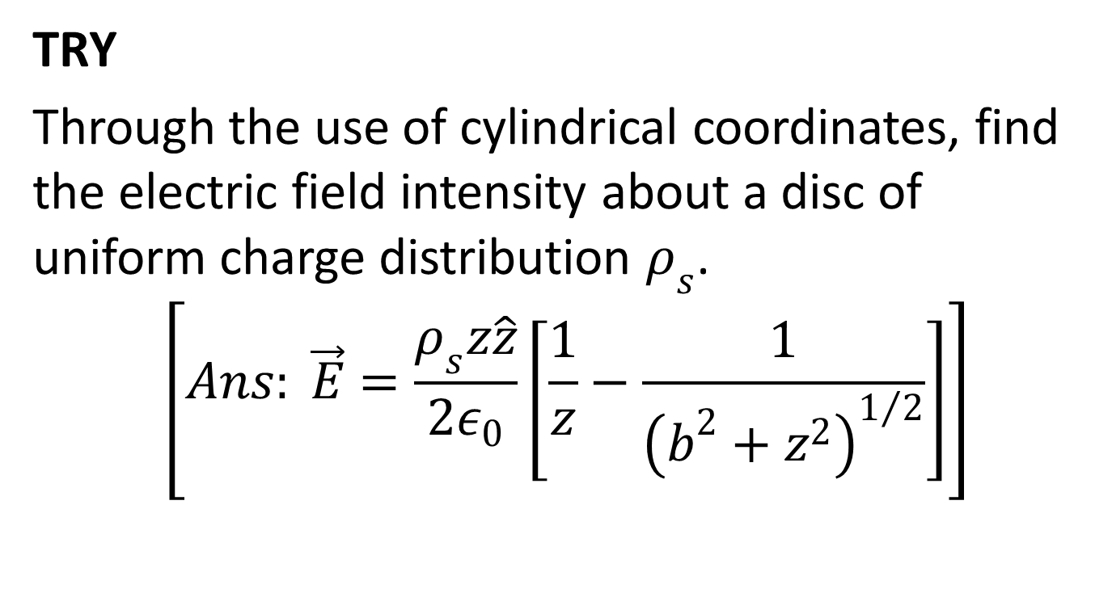
TRY
Through the use of cylindrical coordinates, find the electric field intensity about a disc of uniform charge distribution $ρ_{s}$.
$$\left[Ans: \vec{E}=\frac{ρ_{s}z\hat{z}}{2ε_{0}}\left[\frac{1}{z}−\frac{1}{{\left(b^{2}+z^{2}\right)}^{1/2}}\right]\right]$$

Slide 40
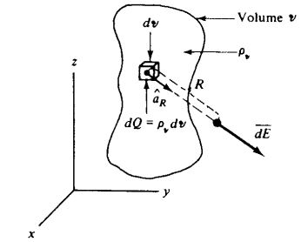
Electric Field Intensity of a Volume of Charge

Slide 41
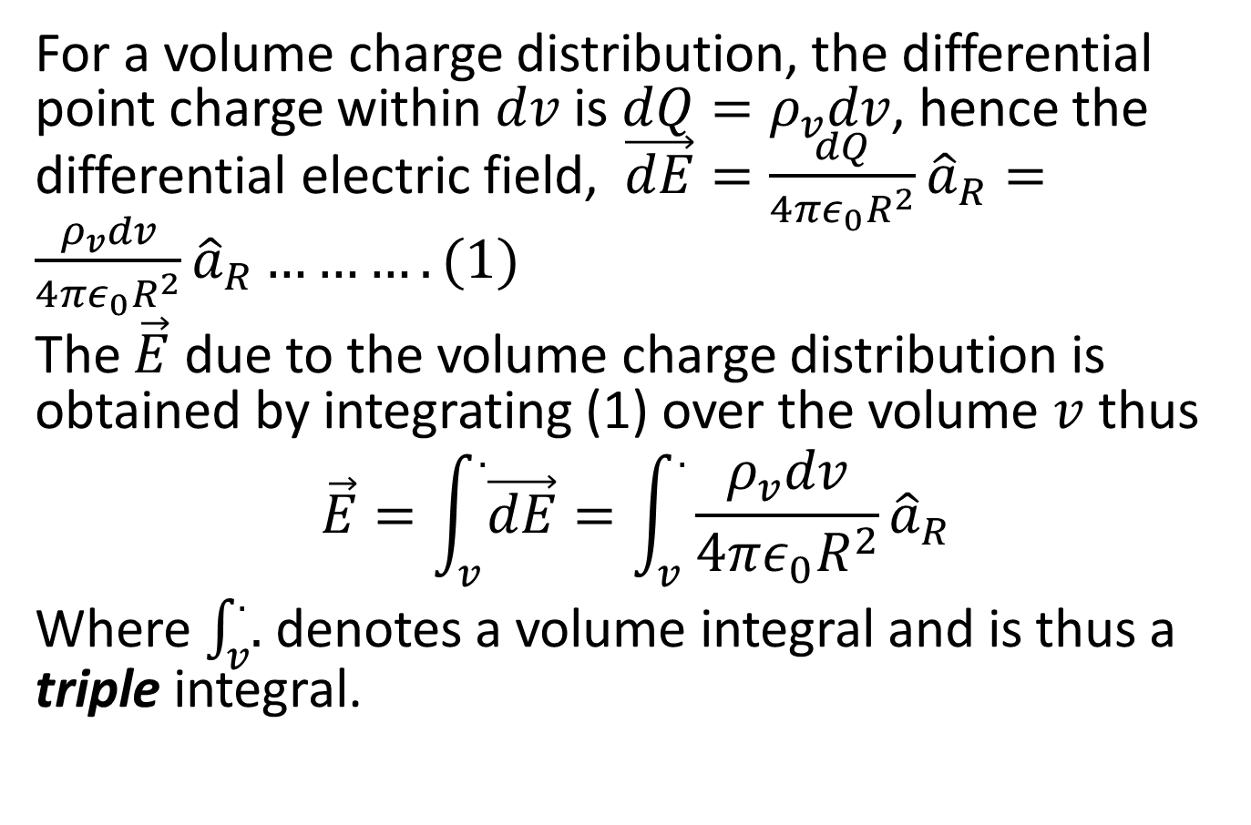
For a volume charge distribution, the differential point charge within $dv$ is $dQ=ρ_{v}dv$, hence the differential electric field, $\vec{dE}=\frac{dQ}{4πε_{0}R^{2}}{\hat{a}}_{R}=\frac{ρ_{v}dv}{4πε_{0}R^{2}}{\hat{a}}_{R}……….(1)$
The $\vec{E}$ due to the volume charge distribution is obtained by integrating (1) over the volume $v$ thus
$$\vec{E}=\int_{v}^{.}{\vec{dE}}=\int_{v}^{.}{\frac{ρ_{v}dv}{4πε_{0}R^{2}}{\hat{a}}_{R}}$$
Where $\int_{v}^{.}{.}$ denotes a volume integral and is thus a triple integral.

